Slide 1
Supporting Permanence, Adoption Assistance, and the Title IV-E Waiver Demonstration Project
Office of the Child’s Representative January 13, 2014
Mary Griffin
Foster Care, Kinship Family Foster Care , RGAP
Program Administrator
Connie Vigil
Adoption
Program Administrator
Paige Rosemond
Title IV-E Waiver Demonstration
Project Administrator

Slide 2
Supporting Permanence
Mary Griffin
Foster Care, Kinship Family Foster Care , RGAP
Program Administrator

Slide 3
Fostering Connections to Success and Increasing Adoptions Act (2008) & Colorado General Assembly
Focused on permanency and permanent connections
Validation of the importance of family/kin relationships
Emphasizes family engagement for permanency
Identify, Locate, Notify relatives – Intensive Family Finding
Requires advisement about RGAP
Authorized Title IV-E GAP/ Increasing Adoptions
Non-safety certification standards for relatives
CO General Assembly (2009) Kinship GAP (5th degree of relationship)
Rules effective 2/01/10 – federal approval
CO General Assembly (2012)
Expanded eligible guardians (expanded definition of relative)
Authorized waiver of non-safety certification standards

Slide 4
RGAP
Purpose
Provide assistance to a relative guardian in a defined and limited manner to achieve permanency for an eligible youth or child when reunification and adoption are not appropriate goals….based upon individual needs
Reduce barriers for legal permanency
Increase legal permanency options
Legal Requirements
The county department is financially responsible
The county department has custody and the most recent removal occurred through a court order: OR,
Through a voluntary placement agreement with the subsequent court hearing authorizing the placement
Guardianship must occur through Probate Court or as a Probate matter

Slide 5
Youth/Children
Eligibility
Reunification/adoption ruled out - reasonable efforts have been made to place for adoption and failed
Significant relationship with prospective guardian
12 or older must be consulted
Youth/child has resided with prospective relative guardian for at least 6 consecutive months while fully certified

Slide 6
Siblings
Demonstrate Efforts to place siblings together
When they cannot, ongoing efforts must be made to facilitate placement together
When that cannot occur, there must be efforts/activities to maintain frequent visitation and ongoing connections for siblings that live apart
Siblings may be placed in the same Agreement
When one sibling is Title IV-E eligible and the others meet all other requirements except Title IV-E eligibility, they are all claimable

Slide 7
Prospective Relative Guardian
Eligibility
Relatives, those ascribed by the family as family-like, and/or who had a prior (to placement) significant relationship
Fully certified for at least 6 consecutive months
The prospective relative guardian has a strong commitment to caring for the youth or child

Slide 8
Is this the appropriate goal?
Reunification and adoption not appropriate
Ongoing discussions about permanency and permanency options
Were “N0s” unpacked
Documentation

Slide 9
Documentation
Demonstrate
Why the youth/child should be in a permanent placement with a prospective relative guardian
Why a relative guardianship assistance payment is in the best interests of the youth or child
Efforts to discuss adoption with the prospective relative guardian as the more permanent option for the youth or child
The reasons that the relative is unwilling to adopt…this requires exploration

Slide 10
More Documentation
Permanency Options – Informed Consent
Prospective relative guardian must understand
Significance of permanency through guardianship (VS stable placement-not in FC)
A lifetime family after exiting the relative guardianship assistance program (lifetime legal/physical/emotional safety and security)
Must assure the prospective relative guardian makes a fully informed decision about the permanency options that are available
Discussions must include, and not limited to
Differences between adoption and guardianship
The future relationship with the family
Visitation with siblings and birth or custodial family

Slide 11
More Documentation
Engagement of Youth/Child and Parents
Youth 12 and older must be consulted and the differences between adoption and guardianship explained
Must be able to make an informed decision about whether they want to be in relative guardianship …ongoing discussions
Efforts to discuss the relative guardianship with the family or legal custodian, and if that didn’t occur….why it didn’t
Without parental buy-in …permanency could derail

Slide 12
Good Faith Negotiation
Rate cannot exceed foster care rate (minus respite)
Make a good faith effort to negotiate the Agreement with the prospective relative guardian to meet the needs:
The needs of the youth and child, and
The circumstances of the prospective relative guardian
Review prospective relative guardian’s financial information including assets, liabilities, and insurance benefits for the initial agreement, and any subsequent increases in assistance

Slide 13
Assistance Agreements
Non Title IV-E
(State/County)
Title IV-E
Must have a minimum monthly assistance payment
Categorically eligible for Medicaid
Core
Long-Term
Time-limited
Non-recurring expenses (capped)
Case Services
Monthly assistance payment not required
Medicaid cannot be guaranteed – guardian applies in county of residence
Dormant
Long-Term
Time-Limited
Non-recurring expenses
Case Services
7

Slide 14
Non Recurring Expenses
Required Documentation
In the Agreement prior to the relative guardianship appointment
Up to $2,000-one time (legal, court, other)
Prospective relative guardian must provide evidence of the needs of the youth/child
Provide an itemized statement of the expenses to be reimbursed within one (1) year from the date of the Probate Court appointment of the relative guardianship

Slide 15
Chafee Eligibility
Youth entering RGAP at age 16 or older are eligible for the Chafee Program
The relative guardianship assistance agreement, or
ILP developed on or prior to the eighteenth (18th) birthday may be used in lieu of an FSP

Slide 16
Adoption Assistance
Connie Vigil
Adoption
Program Administrator

Slide 17
Introduction
The what's, who's, how’s and why’s of the Colorado adoption assistance program
You will learn about adoption assistance, its funding and its limitations
Be thinking of any questions or concerns that you might have regarding the program

Slide 18
What’s Happening
Who is eligible for adoption assistance
At what point in a case adoption assistance should be established
Where to look for answers to questions raised about adoption assistance
Difference between IVE and non-IVE adoption assistance
Fostering Connections

Slide 19
What’s Happening
(Continued)
Adoption assistance can be payments and/or services to families when they adopt a child whose special needs are a barrier to his/her adoption (7.306.4).
The assistance is intended to partially assist in the expenses of caring for and raising the child given his/her identified special needs.
Colorado operates two adoption assistance programs:
Title IV-E – federal government participates in adoption assistance payments on behalf of children who meet the eligibility criteria (7.306.41)
State and County-only – Colorado DHS and the custodial county participate in adoption assistance payments on behalf of children who are not Title IV-E eligible. (7.306.42)

Slide 20
Eligibility
Child has special need(s) which act as a barrier to his/her adoption, who is legally free for adoption, and:
is in the legal custody of a county department; or,
the county department has guardianship of the person (child/ren) with the right to consent to his/her adoption; or,
is in the custody of a Colorado non-profit licensed adoption agency and the child(ren) is IV-E eligible; or,
is in the custody of a relative and the child(ren) is IV-E eligible (7.306.4)

Slide 21
Parameters
Counties may make adoption assistance payments at the time of the adoptive placement and continue them after the adoption has been finalized until the child reaches the age of 18 or 21, if the child has a developmental or physical disability that warrants continuation of the assistance.
The amount of the adoption assistance payment shall be based on the child’s need and the family’s circumstances.

Slide 22
County Procedures
Assure that every family who adopts a child with special needs is informed of the availability of adoption assistance.
Prior to negotiating an adoption assistance agreement, the county must determine the child’s IV-E eligibility status.
Utilize financial information regarding the family, including assets, liabilities and insurance benefits in negotiating the initial agreement and any subsequent requests for increases in adoption assistance.
Base the negotiation of the assistance payment on the special needs of the child and the circumstances of the adoptive parent(s).

Slide 23
County Procedures
Negotiate with the parent(s) to request only the amount that is needed by the family to meet the child’s needs. Payments should not be made or based on the projected needs of the child or the family.
The maintenance amount in the agreement may be no more than what the child would receive, if he/she were in foster care at the time of the adoption assistance negotiation.
In adoption, the maximum amount to which a family is entitled to be reimbursed for non-recurring adoption expenses is $800.

Slide 24
IV-E and Non IV-E
Adoption Assistance
Agreements are similar
Families treated equally
Services may vary
If a child is found to be IV-E eligible, he/she is categorically eligible for Medicaid in any state that he might live.
If a child is Non IV-E there are certain states in the U.S. that do not provide courtesy Medicaid through the Interstate Compact on Adoption and Medical Assistance (ICAMA) to children who move to their state and are under an Adoption Assistance Agreement. In these cases, the Adoption Assistance County must provide a private health insurance policy for that child.

Slide 25
Fostering Connections
AFDC De-Linking
Children and youth who are IV-E eligible at the time of adoption even though they were not IV-E in foster care
FFY 2010 – aged 16 and up during that year
FFY 2011 – aged 14 and up
FFY 2012 – aged 12 and up
The two-year decrease in age continues until FFY 2018 when all children will be IVE eligible, if income was the only reason they were found to be not IV-E eligible.
In addition if these children are being adopted with siblings by the same family at the same time, the siblings will also be IV-E eligible.

Slide 26
Fostering Connections
Out-of-Home Placement
Children and youth can also become IV-E eligible at the time of adoption even though they were not IV-E in Foster Care, if they were in out-of-home care for more than 60 consecutive months, regardless of their age.
As in the AFDC de-linking, any siblings adopted with them at the same time and by the same family will also be IV-E eligible.

Slide 27
Fostering Connections
Proof of School Attendance
Upon the child reaching the age of mandatory school attendance for their state of residence, every adoptive parent must provide annual proof to the agency providing adoption assistance that a child or youth is attending school or is being home-schooled unless he/she is physically unable to attend due to illness or physical disability.

Slide 28
Title IV-E Waiver Demonstration Project
Paige Rosemond
Title IV-E Waiver Demonstration
Project Administrator

Slide 29
What is IV-E?
Title IV-E is a section of the Social Security Act enacted in 1980, authorizing funding to States to serve poor children in Foster Care.
IV-E reimburses a portion of the cost a county incurs to:
Place children in foster care,
Pay subsidies to those who adopt special needs to children,
Pay guardianship subsidies to relatives,
Do case planning
Supervise a child’s placement
Recruit, train and supervise foster parents, and
Train persons associated with the child welfare program.

Slide 30
What is IV-E?
IV-E Does not reimburse States for the cost of:
Investigating child abuse or neglect,
Services need by children, their families, or caregivers,
Preventing child abuse, neglect or foster care
Most reimbursements are triggered only when a child is removed from home and placed into foster care.

Slide 31
What is IV-E?
Not all children/youth are IV-E eligible. Initial eligibility is linked to the financial/income status of the home where the child is removed .
Eligibility standards are based on 1996 income levels. These standards are not allowed to be adjusted.

Slide 32
What is a Title IV-E Waiver Demonstration Project?
Section 1130 of the Social Security Act (SSA) authorizes HHS Secretary to approve State demonstrations waiving certain provisions of Titles IV-E and IV-B of the SSA, including eligibility requirements. Thus, increasing the flexibility of how Federal funds are utilized to meet the child welfare needs of a broader population.
The IV-E Waiver shifts funding to pay for
other services, including: prevention,
in-home service, post-permanency supports.

Slide 33
What is a Title IV-E Waiver Demonstration Project?
All projects must have a rigorous evaluation conducted by a third-party evaluator.
All projects must be cost neutral to the Federal government.
The total amount of Federal funds used for the project must not exceed the amount of Federal funds normally allocated under Titles IV-B and IV-E.

Slide 34
The IV-E Waiver in CO
On February 16, 2012, Governor John Hickenlooper unveiled the Child Welfare Master Plan, “Keeping Kids Safe and Families Healthy.” This plan was the foundation of Colorado’s application to participate in the IV-E Waiver - submitted in June, 2012.
Colorado was accepted as a Title IV-E Waiver Demonstration Project site on October 23, 2012

Slide 35
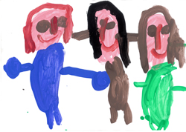
The IV-E Waiver in CO
Through flexibility and focus it is our goal for all 64 counties of Colorado to provide the right support, in the right amount, at the right time, for children and their families.
The IV-E Waiver focuses on three federal goals:
Increasing permanency for children/youth,
Increasing positive outcomes for
children and families, and
Preventing child abuse and neglect
and re-entry to out-of-home care.

Slide 36
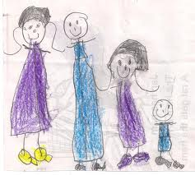
The IV-E Waiver in CO
To achieve these goals, Colorado chose to support 5 interventions:
Family Engagement,
Permanency Roundtables,
Kinship Supports,
Trauma Informed Assessment, and
Trauma Informed Treatment.
Participant Counties must implement at least one of these intervention strategies using evidence-based practices and executed with fidelity.

Slide 37
The IV-E Waiver in CO
In Year 1, 41 counties were awarded $6.7 Million to implement 3 of the interventions as of July 1, 2013: Family Engagement, Permanency Roundtables, and Kinship Supports.
We are continuing to explore the Trauma Informed interventions, with a plan of implementation of
July 1, 2014.

Slide 38
INTERVENTIONS
COUNTY | FAMILY ENGAGEMENT | PERMANENCY ROUNDTABLES | KINSHIP SUPPORTS | COUNTY | FAMILY ENGAGEMENT | PERMANENCY ROUNDTABLES | KINSHIP SUPPORTS
Adams | X | X | X | NE Region - Logan | X | X
Arapahoe | X |  | X | NW Region - Eagle | X | X
Boulder | X |  | X | NW Region - Garfield | X | X | X
Broomfield | X |  |  | NW Region - Moffat | X | X
Central Region - Clear Creek |  | X |  | NW Region - Pitkin | X | X
Central Region - Grand |  | X |  | NW Region - Rio Blanco | X | X
Central Region - Summit | X |  |  | NW Region - Routt | X | X
Chaffee | X |  |  | Park | X
Denver | X |  | X | Pueblo | X | X | X
Douglas | X | X |  | SE Region - Baca | X | X
El Paso | X |  | X | SE Region - Bent | X | X
Fremont |  | X | X | SE Region - Crowley | X
Huerfano | X | X |  | SE Region - Kiowa | X | X
Jefferson | X | X | X | SE Region - Otero |  | X | X
Larimer | X |  | X | SE Region - Prowers |  | X
Las Animas |  | X | X | SW Region - La Plata | X | X | X
Mesa | X | X | X | SW Region - San Juan | X | X | X
Montrose | X | X |  | Teller | X | X
NE Region - Elbert | X | X |  | Weld | X |  | X
NE Region - Kit Carson | X | X | X | Yuma | X | X
NE Region - Lincoln | X |  | X

Slide 39
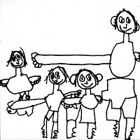
Family Engagement
Please refer to Family Engagement Checklist
Meetings are to occur at case open, at placement, every 90 Days for Out-of-Home Placement, and every 6 months when providing In Home Services
Families are engaged early and
often while involved with child
welfare

Slide 40
Family Engagement Desired Outcomes
For children and youth in out-of-home care:
Increase in stability,
Decrease in length of stay,
Decrease in re-entry,
Decrease in short-term stayers (two weeks or less), and
Decrease the likelihood in the use of congregate care.
For children and youth receiving services in their own home:
Stability in their living situations,
Decrease in maltreatment,
Decrease in trauma to children and youth, and
Increase in the family’s engagement in case planning.

Slide 41
Permanency Roundtables
Please refer to Permanency Roundtable Checklist
Each Roundtable is a structured, professional, case consultation which uses three phases to move the child/youth to permanency.
Attending the PRT are stakeholders, the child/youth, their family/kin and supports, caseworker, supervisor, administrator, and permanency experts.

Slide 42
Permanency Roundtables
The child/youth voice is encouraged and heard. This group drives the Permanency Action Plan. PRTs are held quarterly until the child or youth achieves permanency.
PRT seeks to expedite safe permanency, stimulate thinking and learn about ways to accelerate permanency, and address systemic and cross-systems barriers.
PRTs are to be held quarterly until permanency is achieved and/or case closure.

Slide 43
Permanency Roundtables Desired Outcomes
Decrease in length of stay in out-of-home care,
Decrease in the likelihood that children/youth are placed in congregate care,
Increase in the use of kinship placements,
Increase engagement of youth in case planning, and
Decrease re-entry into out-of-home care.

Slide 44
Kinship Supports
Please refer to Kinship Supports Checklist and Needs Assessment
Kinship Needs Assessment completed within 5 days of contact with Kin
Supports may include:
Clothing
Baby Items
Bedding
Food
Child Care
Rent/Utility Assistance
Transportation
Training
Advocacy
Referral to Community Resources

Slide 45
Kinship Supports Desired Outcomes
Increase the likelihood that kinship placements occur for children/youth removed from their homes,
Decrease in length of stay,
Increase the likelihood that children/youth removed from their home achieve safe permanency through kinship guardianship, and
Increase in stability in out-of-home care.

Slide 46
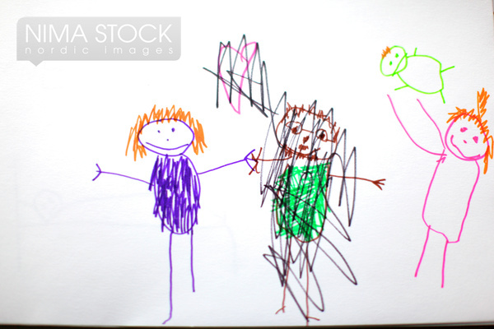
Trauma Informed Assessment
All children and youth with an open case will receive a Trauma Screening.
A trauma informed assessment will occur for those children and youth who have screened positive for trauma impacting their functioning

Slide 47
Trauma Informed Assessment Desired Outcomes
Identification of children and youth where trauma is negatively impacting their lives,
Appropriate referral for trauma-informed treatment,
Decrease in over-reliance on psychotropic medications for children and youth in out-of-home care,
Decrease in the likelihood that children/youth requiring placement are placed in congregate care,
Increase in the likelihood that children/youth removed from their home achieve safe permanency through reunification, and
Improvement in child/youth functioning.

Slide 48
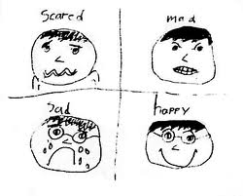
Trauma Informed Treatment
Trauma-informed treatment will occur after a trauma-informed assessment indicates trauma is present and the child/youth has been impacted by it.
A referral for trauma-informed treatment will be made to the Medicaid approved behavioral health provider for children and youth that are Medicaid eligible. For children and youth who are not Medicaid eligible, the referral will
be made either to the community mental
health center or other qualified provider
identified by the county department to
provide trauma-informed treatment.

Slide 49
Trauma Informed Treatment Desired Outcomes
Increase in provision of trauma-informed treatment when a trauma-informed assessment indicates trauma is present and impacting a child’s life,
Decrease in over-reliance on psychotropic medications for children and youth in out-of-home care,
Decrease in the likelihood that children/youth requiring placement are placed in congregate care, and
Improvement in child/youth functioning.

Slide 50
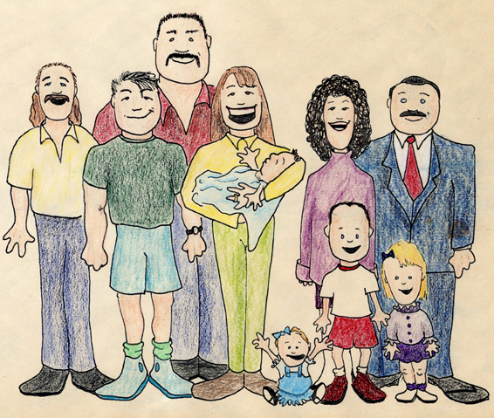
Questions/Comments/Concerns
Mary Griffin
Foster Care, Kinship Family Foster Care, RGAP
Program Administrator
303.866.2866
mary.griffin@state.co.us
Connie Vigil
Adoption Program Administrator
303.866.3209
constance.vigil@state.co.us
Paige Rosemond
Title IV-E Waiver Demonstration
Project Administrator
303.866.2866
paige.rosemond@state.co.us

